Slide 1

Final Year Project On
Multifunctional Arduino/Node MCU Robot Car with Line Following & Avoiding Obstacles
By
1)Ketan Patil
2)Shubham Rathod
3)Rutik Patil
4)Vaishavi Walzade
Under Guide:Prof.V.R Khandve

Slide 2
INDEX
Sr.No | Title | Page no.
1 | Introduction | 3
2 | Problem Definition | 4
3 | Objective | 5
4 | Literature survey | 6
5 | Proposed system | 9
6 | Mathmatical model | 10
7 | Modules | 13
10 | Flowchart & UML Diagram | 21
11 | Circuit Diagram | 22
12 | Final Model Of Project | 23
13 | Project Expenses | 24
14 | Advantages And Disadvantages | 19
15 | Application | 20
16 | Conclusion | 21
17 | References | 23

Slide 3
INTRODUCTION
1]With the increase of technological advancements, everyone wants multitask-enabled products. In the past, numerous robotic cars were built to perform certain type of tasks. With this project, a wide scope of capacities is incorporated into a solitary model of a military automated vehicle, industrial used ,household purpose and many more. The multi-functional robot consist multiple features we control this robot thorough mobile application which we design this app with the help of MIT APP INVENTOR . In this robot we can control the robot through smartphone and also we shift this robot into obstacle avoiding mode through mobile in a single click .
2]When it is shifted to Obstacle Avoiding mode it detect the obstacle in front of him and change the path easily to avoid the obstacle. This also has a features of line follower or we can also say that it follows a track. We add the 1838 IR sensor because of this we can not only control the robot thorough smartphone but also it can control by an transmitter remote. The aim of this project is to develop a prototype of a Multi-functional robot car that performs a various function in order to provide a very powerful and versatile robot while also reducing the hardware usage as much as possible. In this project, Arduino UNO is used as a central component, to which all the other components are interfaced. The designed vehicle is controlled wirelessly through a smartphone with the help of a Bluetooth module.

Slide 4
PROBLEM DEFINITION:
The project is design to build an obstacle avoidance robotic vehicle using ultrasonic sensors for its movement. A microcontroller (ATmega328) is used to achieve the desired operation. A robot is a machine that can perform task automatically or with guidance. The project proposes robotic vehicle that has an intelligence built in it such that it directs itself whenever an obstacle comes in its path. This robotic vehicle is built, using a micro-controller of AT mega 328 family. An ultrasonic sensor is used to detect any obstacle ahead of it and sends a command to the micro-controller. Depending on the input signal received, the micro-controller redirects the robot to move in an alternate direction by actuating the motors which are interfaced to it through a motor driver. Some of the project is built with the IR sensors has its own application so in our project those application is not compactable so we are using ultrasonic sensor.

Slide 5
OBJECTIVE
Navigate safely by avoiding obstacles comes ahead.
Detecting the exact path by checking the sensor readings in different angles.
Send status of the robot movement (using Bluetooth module) to the nearby android phone when the robot is in automatic mode.
Navigate in manual mode by receiving signals from the phone.
Advanced Driver Assist System (ADAS).

Slide 6
LITERATURE SURVEY
Author Name | Publication Year | Project Name | Advantages | Disadvantages
1)D. Vijendra Babu 2)D. C. Jenniffer R. Karthikeyan | 28 September 2020 | Line follower robot & obstacle detection using PID controller[1] | Can detect Obstacle and takes turns on its own Follows a predefined line | Robot moves on its own, Have no way to control its direction manually.

Slide 7
Author Name | Publication Year | Project Name | Advantages | Disadvantages
1)Tajim Md. Niamat Ullah Akhund 2) Nishat Tasnim Newaz | September 2020 | IoT Waiter Bot: A Low Cost IoT based Multi Functioned Robot for Restaurants | Detects Obstacle On it’s own and waits for obstacle to clear down | Robot has to wait until the obstacle clears the predefined path. Only follows predefined path which is black line.

Slide 8
Author Name | Publication Year | Project Name | Advantages | Disadvantages
Sushama Gavarskar Jagruti Chaudhari | September 2019 | Line Following Robot Using Arduino for Hospitals | Reduces Human Work of transportation. | This Robot can’t be use in low light conditions The Robot requires smooth surface to follow path

Slide 9
Author Name | Publication Year | Project Name | Advantages | Disadvantages
Richard T. Vannoy | December 2007 | Building a Line Following Robot | Robot follow a predefined black line to reach it’s destination. | Robot can not move in other direction. Have no manual control over its direction.

Slide 10
Author Name | Publication Year | Project Name | Advantages | Disadvantages
1)Shubh Srivastav 2)Rajanish Singh | May 2020 | Voice Control Robot Car using Arudino uno | Used to monitoring or investigation Less Space Required

Slide 11
Author Name | Publication Year | Project Name | Advantages | Disadvantages
1)Mr.Vineeth Teeda 2)Mrs.K.Sujatha 3)Mr.Rakesh Muthukuru | Augest 2016 | Voice Control Robot Car using Arudino uno | Used in Chemical Industry | Sometimes we lost the connection.

Slide 12
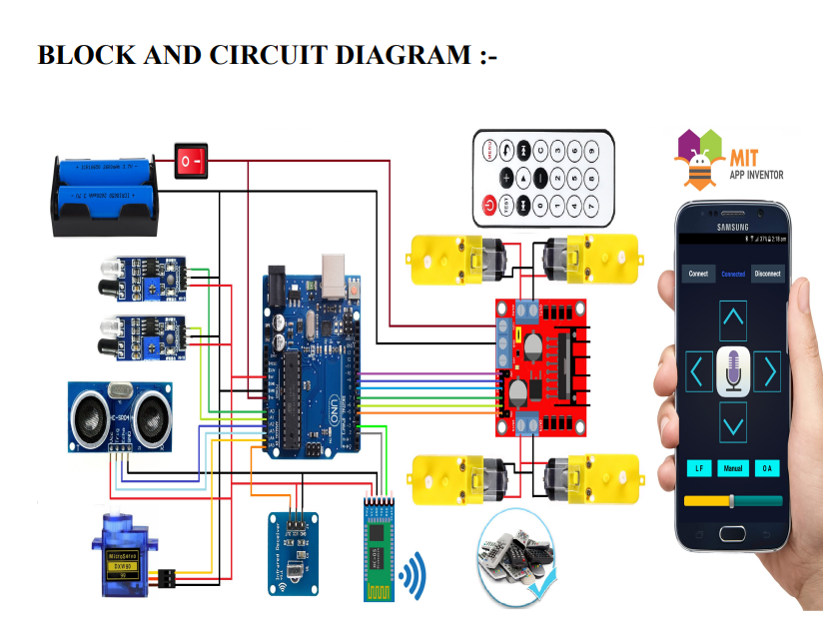




Circuit Diagram Of Arudino UNO
IR REMOTE
POWER SUPPLY
SWITCH
ARUDINO UNO
IR RECEIVER
L298N
MOTOR
DRIVER
SHIELD
ULTRASONIC SENSOR
APPLICATION
SG90 DC SERVO MOTOR
HC5 BLUETOOTH MODEL

Slide 13
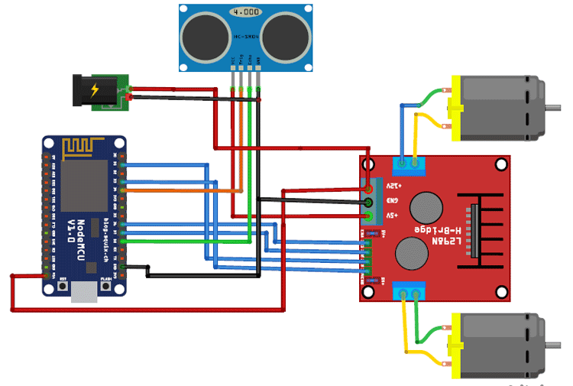
Circuit Diagram Of NODE MCU

Slide 14
MATHEMATICAL MODEL
Input Set = {B1,B2,B3,B4,B5,V1,V2,V3,V4,V5,M,L,O}
Where,
B1 = Forward Button V1 = Voice Forward command M = Manual Mode
B2 = Back Button V2 = Voice Back command L = Line Follower Mode
B3 = Left Button V3 = Voice Left command O = Obstacle Avoiding Mode
B4 = Right Button V4 = Voice Right command
B5 = Stop V5 = Voice Stop command
Process Set = {S1, S2, S3, S4, S5, S8, S9, S10, S130}
Where,
S1 = Send 1 To Arduino S8 = Send 8 To Arduino
S2 = Send 2 To Arduino S9 = Send 9 To Arduino
S3 = Send 3 To Arduino S10 = Send 10 To Arduino
S4 = Send 4 To Arduino S130= Send 130 To Arduino
S5 = Send 5 To Arduino

Slide 15
Output Set = {F, B, L, R, S, M, O, L}
Where,
F = Moves Forward
B = Moves Backward
L = Turns Left
R = Turns Right
S = Stop
M = Enter In Manual Mode
O = Enters In Obstacle Avoiding Mode
L = Enters in Line Follower Mode

Slide 16
Mathematical Model:
S1
S2
S3
S4
S5
S8
S9
S10
B1
B2
B3
B4
B5
V1
V2
V3
V4
V5
M
L
O
F
B
L
R
S
M
O
L

Slide 17
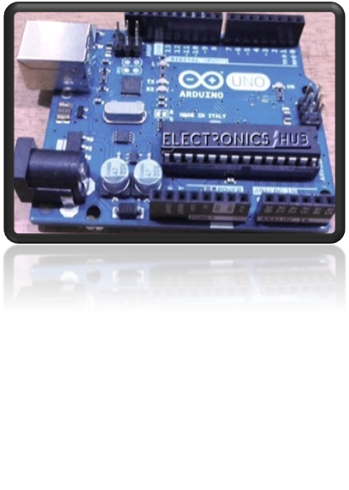
Modules
1)Arduino UNO Board
Arduino is an open source electronics platform that is based on the easy-to-use software and hardware. Arduino board are able to read inputs (like light glowing on a sensor, a finger touched on a button, or a message of Twitter) and turn it into an output (like activating motors, turning on an LED, publishing some content online). We can tell our board what to do by sending a group of instructions to the microcontroller on the board. Over many years, Arduino has been the brain of hundreds and thousands of projects, from day-to-day objects to complex scientific instruments. It was developed at the Ivrea Interaction Design Institute, which aims to help students without a background in electronics and programming for fast prototyping. Thanks to its simple user experience, Arduino has been used in hundreds and thousands of different projects and applications. The software of Arduino is easy-to-use for beginners and flexible enough for advanced users. It runs on Mac, Windows, and Linux. There are many other microcontrollers and microcontroller platforms other than Arduino available for physical computing. Arduino has simplified the process of working with microcontrollers. It also offers some advantages for teachers, students, and interested amateurs over other systems

Slide 18
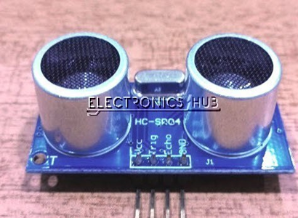
2) Ultrasonic Sensor
An ultrasonic sensor is an electronic device that measures the distance of a target object by emitting ultrasonic waves, and then converting the reflected waves into an electrical signal. Ultrasonic waves travel way faster than the speed of audible sound (i.e. the sound that humans can hear). Ultrasonic sensors have two main components: the receiver and the transmitter. The transmitter emits the sound using piezoelectric crystals and the receiver encounters the sound after it has travelled to and from the target. To calculate the distance between the sensor and the object, the sensor measures the time taken between the emission of the sound by the transmitter to its contact with the receiver. Ultrasonic sensors are used firstly and commonly as proximity sensors. They can be found in an anti-collision safety systems and automobile self-parking technology. In comparison to Infrared sensors in proximity sensing applications, ultrasonic sensors are not as susceptible to interference of smoke, gas, and other airborne particles

Slide 19
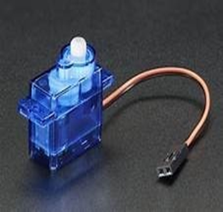
3)Servo Motor (Tower Pro SG90)
A servomotor is a linear actuator or a rotary actuator that allows for accurate control of linear or angular position, acceleration and velocity. It consists of a sensor coupled with motor for position feedback. It also requires a relatively sophisticated controller, designed specifically for use with servomotors. The servo motor is a simple DC motor. With the help of servomechanism, it is controlled for specific angular rotation. Now-a-days, servo motors are widely used in many industrial applications. In the obstacle avoiding robot, it is used for rotating the ultrasonic sensors. Whenever any obstacle comes in front of it, the robot detects it and stops and then after that servo motor rotates in both left and right directions. Along with the servo motor, the ultrasonic sensor which is mounted on it also rotates

Slide 20
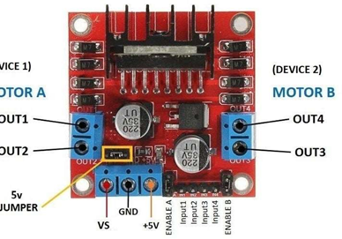
4) Motor Drive
A motor driver is an integrated circuit chip. It is mostly used to control motors in an autonomous robot. Motor driver IC act as an interface between the motors in robot and the microprocessors in the robot. L293 series such as L293D, L293NE etc. are the most commonly used motor drivers. These motor drivers are designed to control two DC motors together. L293D consist of two Hbridge. H-bridge is the simplest of all circuits for controlling a low current rated motor. The L293D IC receives signals from the microprocessor and transmits relative signal to the motors. It has two voltage pins, one of which is used to apply voltage to the motors and the other is used to draw current for the working of the L293D.
Servo Motor

Slide 21
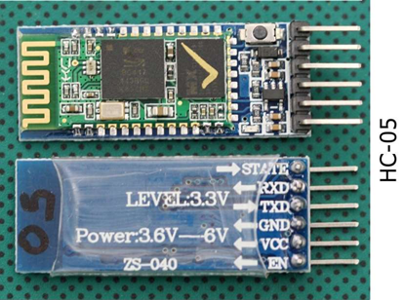
5) HC 05 Bluetooth Module
HC-05 Bluetooth Module is an easy to use Bluetooth SPP (Serial Port Protocol) module, designed for transparent wireless serial connection setup. It has 6 pins. EN (enable),VCC,GND,TXD,RXD & STATE. Designed to replace cable connections HC-05 uses serial communication to communicate with the electronics. Usually, it is used to connect small devices like mobile phones using a short-range wireless connection to exchange files. It uses the 2.45GHz frequency band.

Slide 22
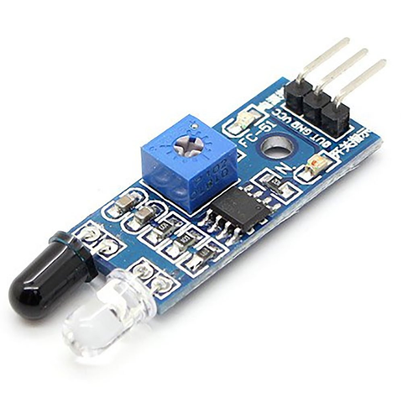
6)IR SENSOR
An IR proximity sensor works by applying a voltage to the onboard Infrared Light Emitting Diode which in turn emits infrared light. This light propagates through the air and hits an object, after that the light gets reflected in the photodiode sensor. If the object is close, the reflected light will be stronger, if the object is far away, the reflected light will be weaker. If you look closely toward the module. When the sensor becomes active it sends a corresponding Low signal through the output pin that can be sensed by an Arduino or any kind of microcontroller to execute a particular task. The one cool thing about this module is that it has two onboard LEDs built-in, one of which lights on when power is available and another one turns on when the circuit gets triggered. An IR proximity sensor works by applying a voltage to the onboard Infrared Light Emitting Diode which in turn emits infrared light. This light propagates through the air and hits an object, after that the light gets reflected in the photodiode sensor. If the object is close, the reflected light will be stronger, if the object is far away, the reflected light will be weaker. If you look closely toward the module. When the sensor becomes active it sends a corresponding Low signal through the output pin that can be sensed by an Arduino or any kind of microcontroller to execute a particular task. The one cool thing about this module is that it has two onboard LEDs built-in, one of which lights on when power is available and another one turns on when the circuit gets triggered.

Slide 23
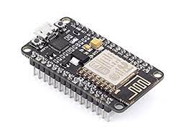
7) NODE MCU
The NodeMCU (Node MicroController Unit) is an open-source software and hardware development environment built around an inexpensive System-on-a-Chip (SoC) called the ESP8266. The ESP8266, designed and manufactured by Espressif Systems, contains the crucial elements of a computer: CPU, RAM, networking (WiFi), and even a modern operating system and SDK. That makes it an excellent choice for Internet of Things (IoT) projects of all kinds.
The NodeMCU is available in various package styles. Common to all the designs is the base ESP8266 core. Designs based on the architecture have maintained the standard 30-pin layout. Some designs use the more common narrow (0.9″) footprint, while others use a wide (1.1″) footprint – an important consideration to be aware of.
The most common models of the NodeMCU are the Amica (based on the standard narrow pin-spacing) and the LoLin which has the wider pin spacing and larger board. The open-source design of the base ESP8266 enables the market to design new variants of the NodeMCU continually

Slide 24
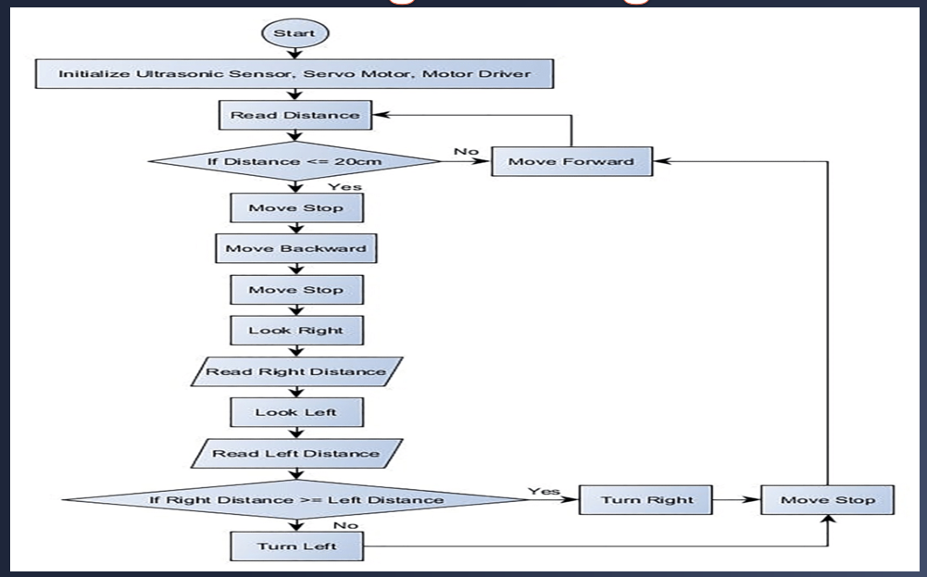
Obstacle Avoiding Working Flowchart:

Slide 25
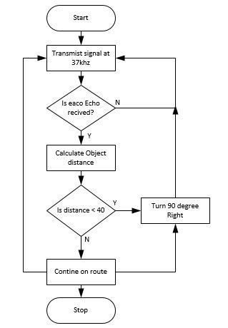
Activity Diagram Of Obstacles Avoiding

Slide 26
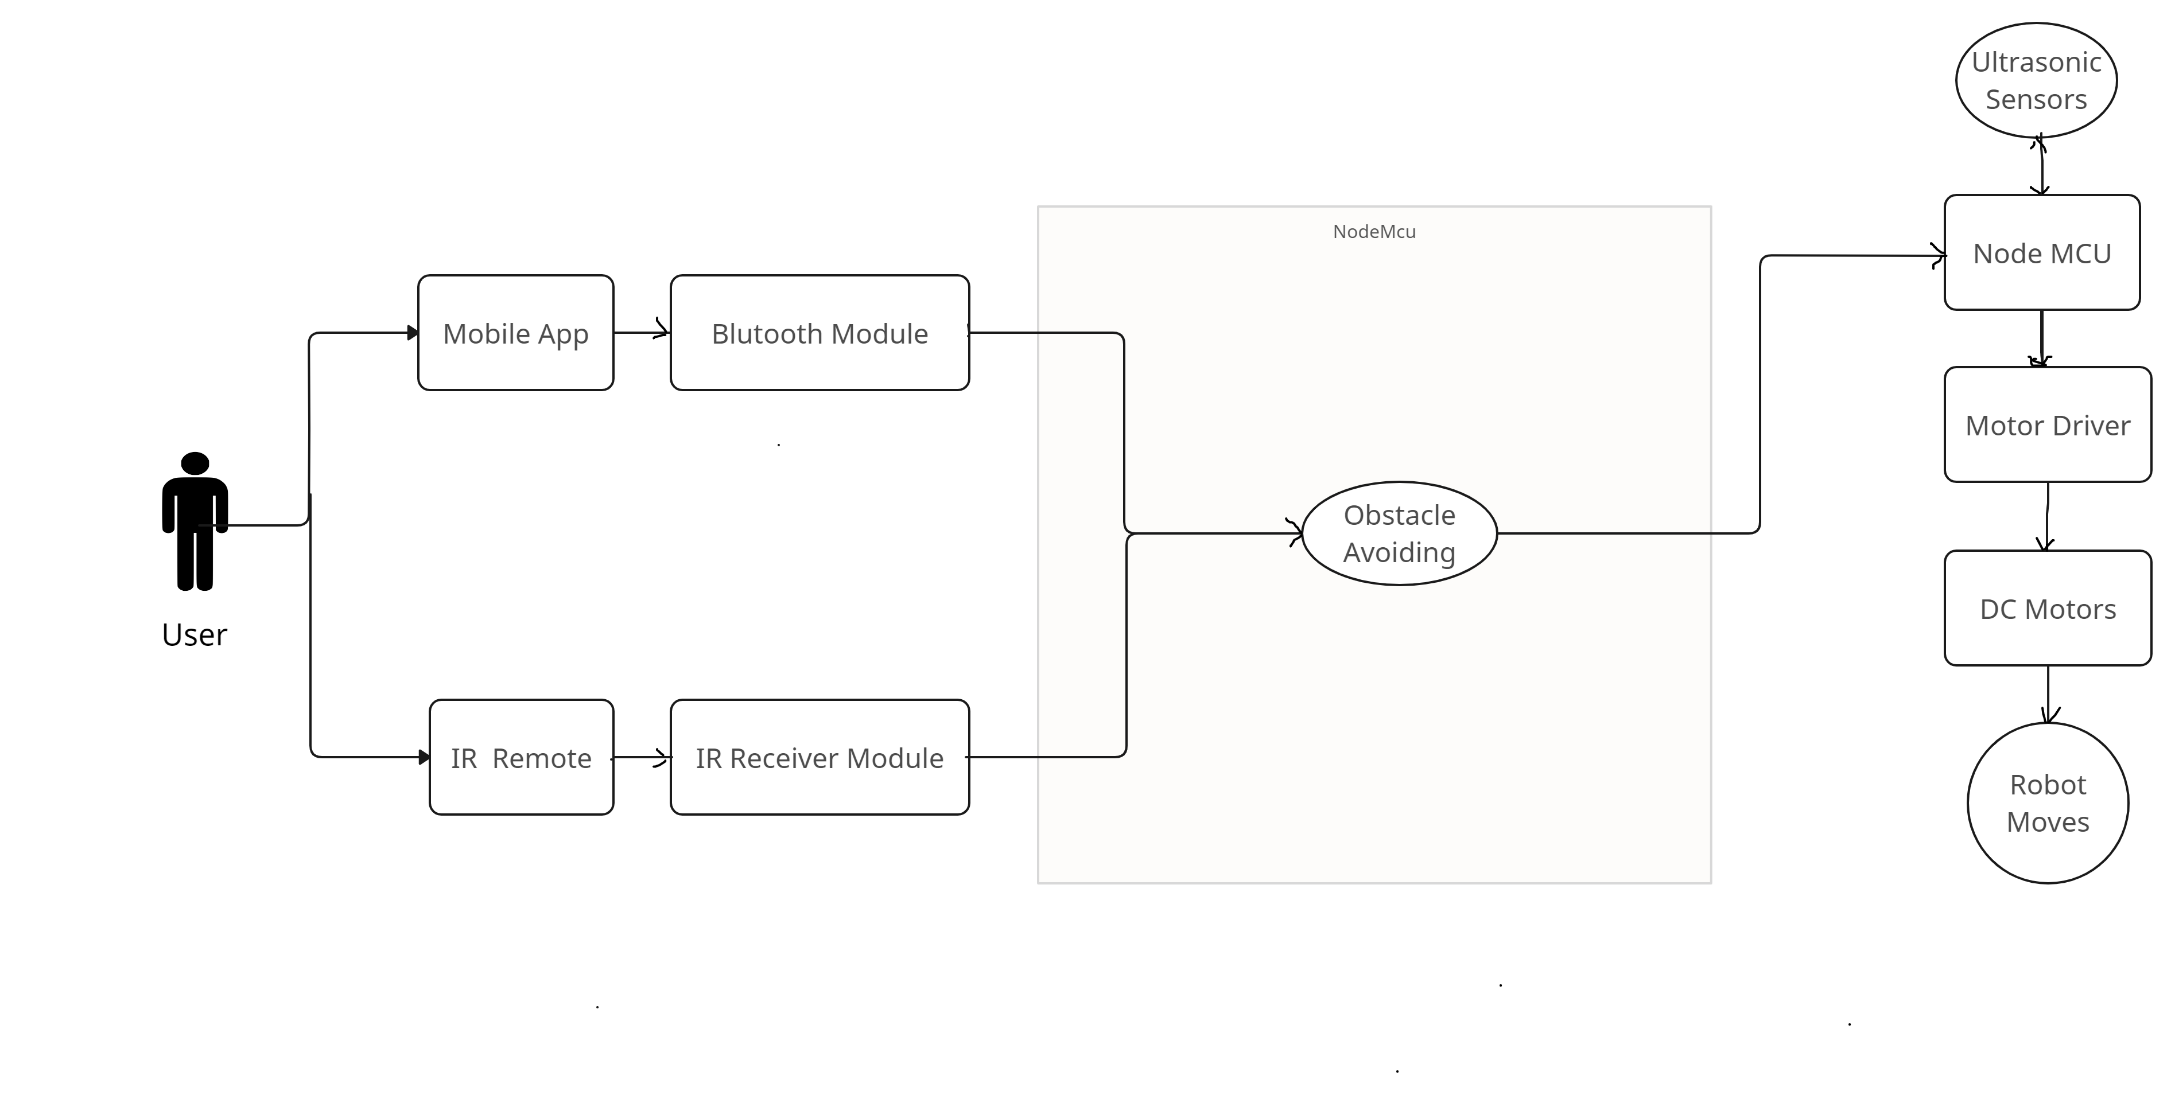
Use Case Of Obstacles Avoiding

Slide 27
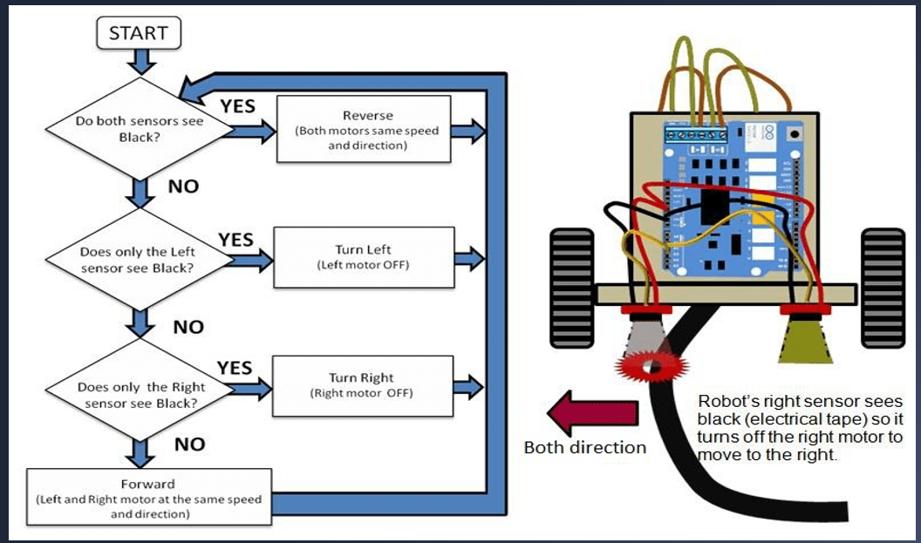
LINE FOLLOWER WORKING FLOWCHART

Slide 28

Use case of Line Following

Slide 29
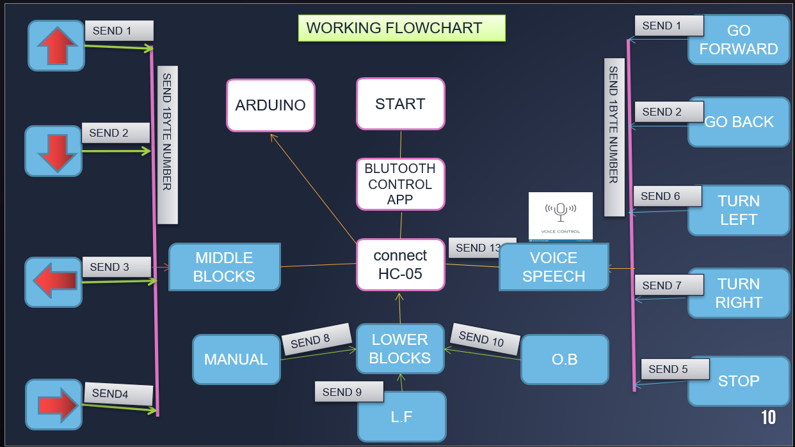
Working Flowchart For Mobile App

Slide 30
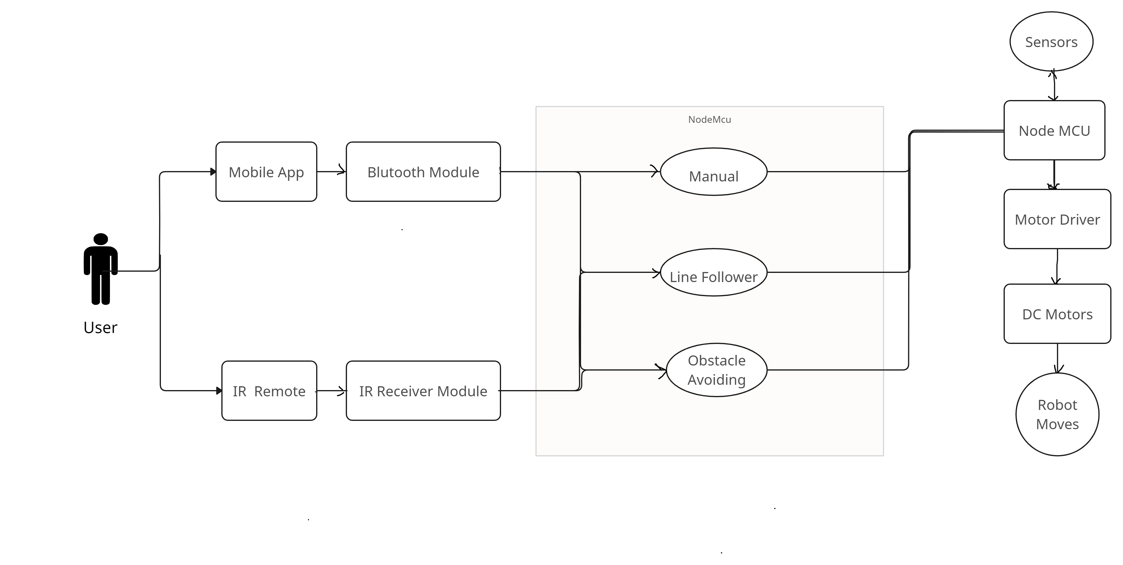
Use Case of Bluetooth/ Wifi Control

Slide 31
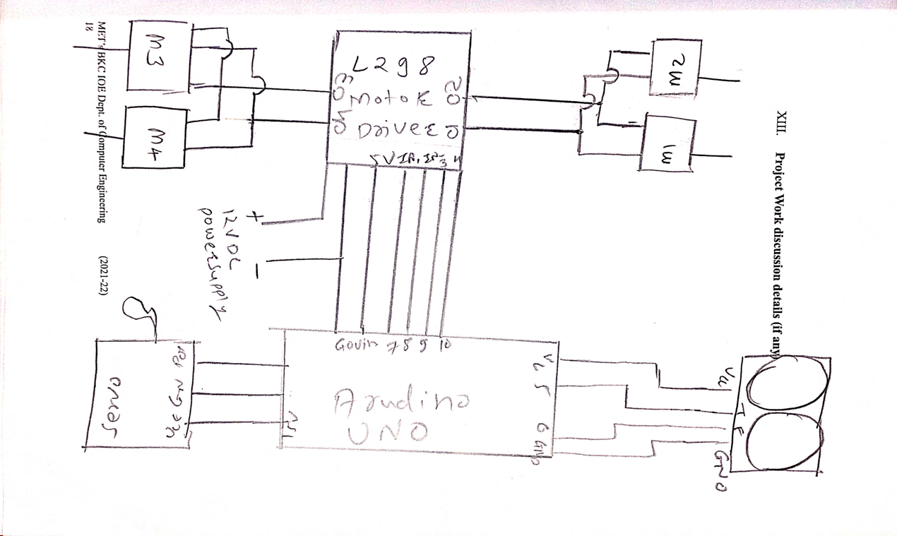
Circuit Diagram

Slide 32
Test Case of Arudino Uno
Condition | Test Case Results
Obstacle Avoiding | It works properly. The robot car moving with Servo motor. Measure all side with the help of servo motor. And when the distance is calculated, it compares and the side whose distance he is less than 20 will take a turn on the robot and move forward.
Line Following | It follows the black line with their IR sensor. It stops when object is present on the line. When the object is moved from the line then robot car is follows the line.
Bluetooth Control and Voice control | It is control by open source mobile application. We can use voice as well as Navigation control.

Slide 33
Test Case of NODE MCU
Condition | Test Case Result
Obstacle Avoiding | When we use Node MCU some Problem seen in the servo motor. When object is detected then whole motor turns right or left side .
WIFI Control | In this module we use the Node MCU. We can control the car from any where . There is no limit for NODE MCU.
line following | It follows the black line with their IR sensor. It stops when object is present on the line. When the object is moved from the line then robot car is follows the line.

Slide 34
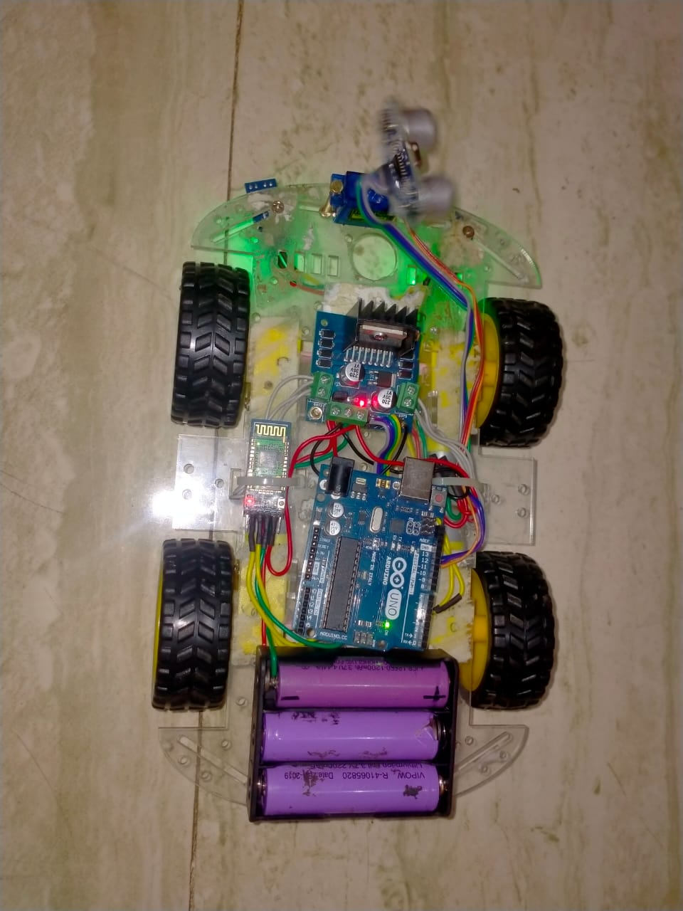
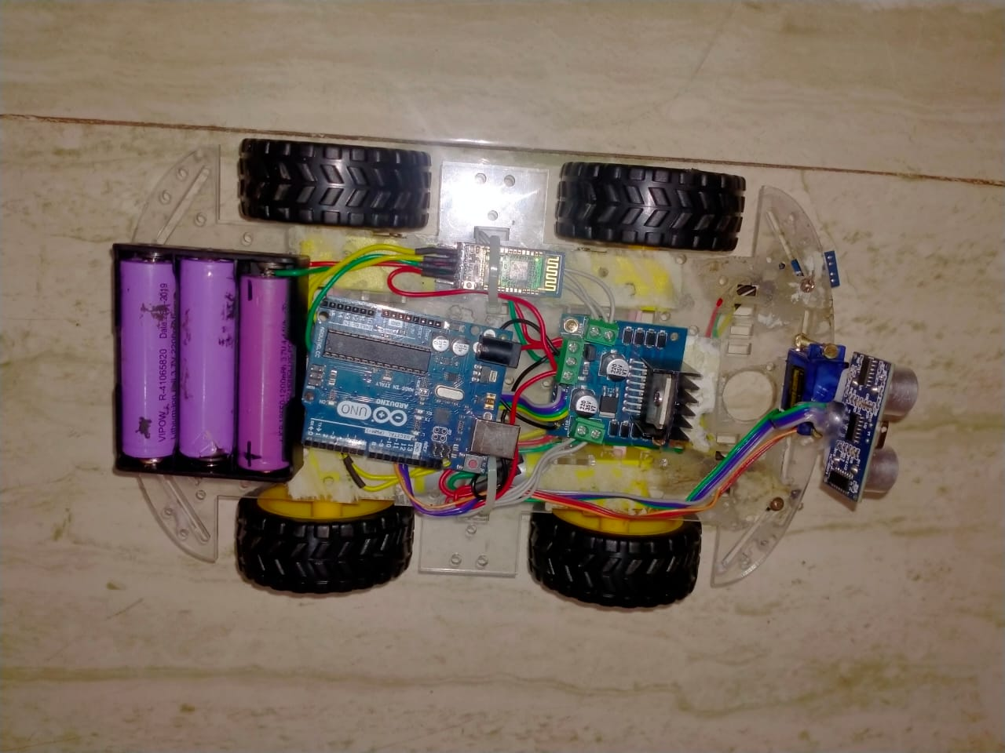
FINAL MODEL MULTIFUNCTIONAL ROBOT

Slide 35
PROJECT COMPONENTS EXPENSES
Components | Price
ARDUINO UNO R3 | 700 Rs
ULTRASONIC SENSOR | 750 Rs
SG90 DC SERVO MOTOR | 650 RS
L298N MOTOR DRIVER SHIELD | 500 RS
HC-05 BLUTOOTH MODULE | 500 Rs
TSOP1838 IR RECEIVER | 500 Rs
NODE MCU | 450 RS
TOTAL | 3600 RS

Slide 36
ADVANTAGES
The system can be used in Automated vehicle.
The system can be Space Mission.
The system can be used in Mines.
The system can Also be controlled by wirelessly using Android Phone .
It is low cost system.

Slide 37
DISADVANTAGES
-This system is Fragile ,So it should be handle carefully.

Slide 38
APPLICATION
It is used in dangerous environment ,where human penetraion is impossible.
It is used in almost all mobile robot navigation system.
It can be used in unmanned space mission.
Counting instruments access switches parking meters.
Back sonar of automobiles.

Slide 39
CONCLUSION
In this work, the field of Robotics is investigated and a robotic car equipped with many functionalities is proposed. The designed model works on wireless remote control with the help of android application which is connected to bluetooth module it also contain obstacle avoiding features , line follower ,voice control and remote control .
During the project, the complete working of Arduino UNO and a variety of sensors is executed and understood. Coding and designing skills form the base and are utilized in the project. The project gives profound knowledge into different advancements and devices for improvement of the venture.

Slide 40
[1]. T. L. Chien, H. Guo, K. L. Su and S. V. Shiau, "Develop a Multiple Interface Based Fire Fighting Robot," 2007 IEEE International Conference on Mechatronics, Changchun, Jilin, 2007, pp. 1-6, doi: 10.1109/ICMECH.2007.4280040.
[2]. S. Mandal, S. K. Saw, S. Maji, V. Das, S. K. Ramakuri and S. Kumar, "Low cost arduino WiFi /bluetooth integrated path following robotic vehicle with wireless GUI remote control," 2016 International Conference on Information Communication and Embedded Systems (ICICES), Chennai, 2016, pp. 1-5.
[3]. H. Rissanen, J. Mahonen, K. Haataja, M. Johansson, J. Mielikainen and P. Toivanen, "Designing and implementing an intelligent Bluetooth enabled robot car," 2009 IFIP International Conference on Wireless and Optical Communications Networks, Cairo, 2009, pp. 1-6.
[4]. Zhao Wang, Eng Gee Lim, Weiwei Wang, M. Leach and Ka Lok Man, "Design of an arduino-based smart car," International SoC Design Conference (ISOCC), Jeju, pp. 175-176, 2014.
[5]. N. Firthous Begum, P. Vignesh. Design and Implementation of Pick and Place Robot with Wireless Charging Application, International Journal of Science and Research (IJSR), ISSN (Online): 2319-7064, 2013.
REFERENCES

Slide 41
[4]. Zhao Wang, Eng Gee Lim, Weiwei Wang, M. Leach and Ka Lok Man, "Design of an arduino-based smart car," International SoC Design Conference (ISOCC), Jeju, pp. 175-176, 2014
[5]. N. Firthous Begum, P. Vignesh. Design and Implementation of Pick and Place Robot with Wireless Charging Application, International Journal of Science and Research (IJSR), ISSN (Online): 2319-7064, 2013.
6] Bhagya shree S R , Manoj kollam “Zigbee Wireless Sensor Network For Better Interactive Industrial Automation” , proc.of IEEE ICoAC2011,pp 304-308,2011.
7] Ming Chang, Descriptive Geometry and Engineering Graphics 3 ed. Huazhong University of Science and Technology press, 2004
8] Shiquan Zhou, Fundamentals for Mechanical Manufacturing Process in Huazhong University of Science and Technology press, 2005 .
9] Jiao Ni, Guoqing Li, Qin Qian, Mechanical of Materials,Huazhong University of Science and Technology press, 2006

